Slide 1
The Battle of the Schedulers
username

Slide 2
Contents
ABSTRACT. 1 Introduction. 2 Overview of CFS and ULE. 2. 1 Linux CFS.

Slide 3
Contents
2. 2 FreeBSD ULE. 3 Porting ULE to the Linux kernel. 4 Experimental environment. 4. 1 Machines.

Slide 4
Contents
4. 2 Workloads. 5 Evaluation of per-core scheduling. 5. 1 Fairness and starvation when co-scheduling applications. 5. 2 Fairness and starvation within a single application.

Slide 5
Contents
5. 3 Performance analysis. 6 Evaluation of the load balancer. 6. 1 Periodic load balancing. 6. 2 Thread placement.

Slide 6
Contents
6. 3 Performance analysis. Performance. 6. 4 Multi application workloads. 7 Related works. -20 -40 -80 Perf. Improved relative to running alone on CFS -60. 8 Conclusion. REFERENCES.

Slide 7
ABSTRACT.
The Battle of the Schedulers

Slide 8
ABSTRACT.
This paper analyzes the impact on application performance of the design and implementation choices made in two widely used open-source schedulers: ULE, the default FreeBSD scheduler, and CFS, the default Linux scheduler. We compare ULE and CFS in otherwise identical circumstances.ULE may cause starvation, even when executing a single application with identical threads, but this starvation may actually lead to better application performance for some workloads.

Slide 9
1 Introduction.
The Battle of the Schedulers

Slide 10
1 Introduction.
Operating system kernel schedulers is responsible for maintaining high utilization of hardware resources while providing faster response time to latency-sensitive applications. Our goal is not to declare an overall winner. In fact, we find that for some workloads ULE is better and for others CFS is better.

Slide 11
1 Introduction.
We first examine the impact of the per-core scheduling decisions made by ULE and CFS, by running applications and combinations of applications on a single core, We then run the applications on all cores on the machine, and study the impact of the load balancer. The outline of the rest of this paper is as follows. Section 3 describes our port of ULE to Linux and the main differences between the native ULE implementation and our port.

Slide 12
2. 1 Linux CFS.
The Battle of the Schedulers

Slide 13
2. 1 Linux CFS.
Per-core scheduling: Linux's CFS implements a weighted fair queueing algorithm: it evenly divides CPU cycles between threads weighted by their priority [18]. Since CFS schedules the thread with the lowest vruntime, CFS needs to prevent a thread from having a brainstorm much lower than the vruntimes of the other threads waiting to be scheduled.

Slide 14
2. 1 Linux CFS.
Using the minimum vruntime also ensures that threads that sleep a lot are scheduled first, a desirable strategy on desktop systems, because it minimizes the latency of interactive applications. Load balancing also happens periodically.

Slide 15
2. 2 FreeBSD ULE.
The Battle of the Schedulers

Slide 16
2. 2 FreeBSD ULE.
Per-core scheduling: ULE uses two runqueues to schedule threads: one run queue contains interactive threads, and the other contains batch threads. To classify threads, ULE first computes a score defined as interactivity penalty + niceness.

Slide 17
2. 2 FreeBSD ULE.
If this also fails, ULE simply picks the car with the lowest number of running threads on the machine. ULE also balances threads when the interactive and batch runqueues of a core are empty.

Slide 18
3 Porting ULE to the Linux kernel.
The Battle of the Schedulers

Slide 19
3 Porting ULE to the Linux kernel.
In this section we describe the problems encountered when porting ULE to Linux, and the main differences between our port and the original FreeBSD code.The Linux kernel offers an API to add new schedulers to the kernel.

Slide 20
3 Porting ULE to the Linux kernel.
 | CFS | ULE
Fibo - Runtime | 160s | 158s
Sysbench - Transactions/s | 290 | 532
Sysbench - Avg. latency | 441ms | 125ms
In ULE, a thread that runs on a core is removed from the runqueue data structure, and added back when its time slice is depleted, so that the FIFO property holds.

Slide 21
3 Porting ULE to the Linux kernel.
Because of that, we had to slightly change the ULE load balancing to avoid migrating a currently running thread.

Slide 22
4. 1 Machines.
The Battle of the Schedulers

Slide 23
4. 1 Machines.
We evaluate ULE on a 32-core machine with 32GB of RAM.

Slide 24
4. 2 Workloads.
The Battle of the Schedulers

Slide 25
4. 2 Workloads.
To assess the performance of CFS and ULE, we used both synthetic benchmarks and realistic applications. Fib is a synthetic application computing Fibonacci numbers.Hackbench [10] is a benchmark designed by the Linux community to stress the scheduler.

Slide 26
5 Evaluation of per-core scheduling.
The Battle of the Schedulers

Slide 27
5 Evaluation of per-core scheduling.
In this section, we run applications on a single core to avoid possible side effects introduced by the load balancer. We first analyze the impact of this design decision by co-scheduling a batch and an interactive application on the same core, and we show that under ULE batch applications can starve for an unbounded amount of time.We then show that starvation under ULE can occur even when the system is only running a single application.

Slide 28
5. 1 Fairness and starvation when co-scheduling applications.
The Battle of the Schedulers

Slide 29
5. 1 Fairness and starvation when co-scheduling applications.
In this section, we analyze the behavior of CFS and ULE running a multi-application workload consisting of a compute-intensive thread that never sleeps, and an application whose threads mostly sleep.
40 10 wrt CFS) 0 ULE

Slide 30
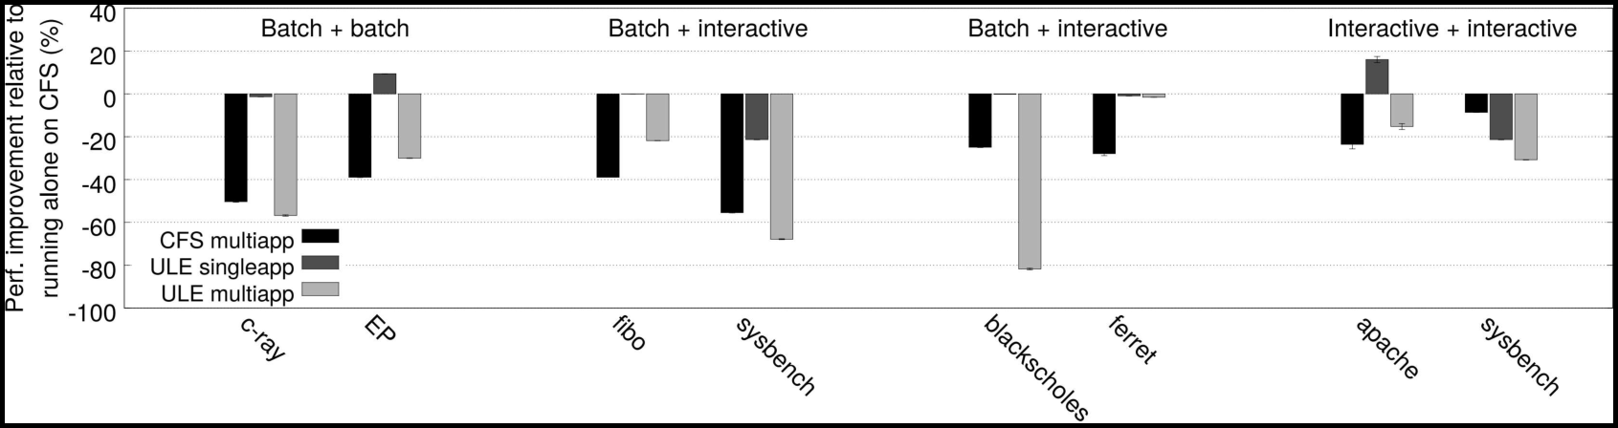
5. 1 Fairness and starvation when co-scheduling applications.
Thus, sysbench threads get absolute priority over the fiber thread.

Slide 31
5. 1 Fairness and starvation when co-scheduling applications.
Thus, sysbench threads get absolute priority over the fiber thread.

Slide 32
5. 1 Fairness and starvation when co-scheduling applications.
Thus, sysbench threads get absolute priority over the fiber thread.

Slide 33
5. 1 Fairness and starvation when co-scheduling applications.
Sysbench runs 50% slower on CFS, because it shares the CPU with fibo, instead of running in isolation, as it does with ULE.

Slide 34
5. 2 Fairness and starvation within a single application.
The Battle of the Schedulers

Slide 35
5. 2 Fairness and starvation within a single application.
The starvation exhibited by ULE in the multi-application scenario above also occurs in single-application workloads.Since these threads spend most of their time waiting for new requests, their interactivity penalty stays low, and their priority remains higher than that threads that were forked late in the initialization process.

Slide 36
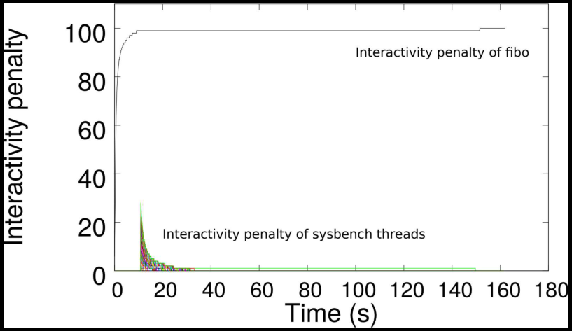
5. 2 Fairness and starvation within a single application.
Interactivity penalty Interactivity penalty Interactivity penalty of five Interactivity penalty of sysbench threads 20 40 60 80 100 120 140 160 180 Time Figure 2: Interactivity penalty of threads over time.

Slide 37
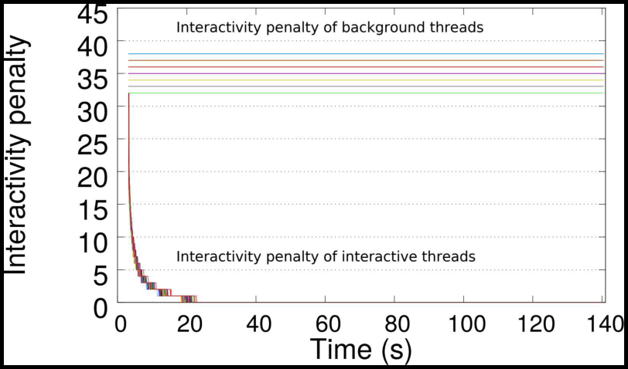
5. 2 Fairness and starvation within a single application.
Interactivity penalty Interactivity penalty Interactivity penalty of five Interactivity penalty of sysbench threads 20 40 60 80 100 120 140 160 180 Time Figure 2: Interactivity penalty of threads over time.

Slide 38
5. 3 Performance analysis.
The Battle of the Schedulers

Slide 39
5. 3 Performance analysis.
We now analyze the impact of the per-core scheduling on the performance of 37 applications.

Slide 40
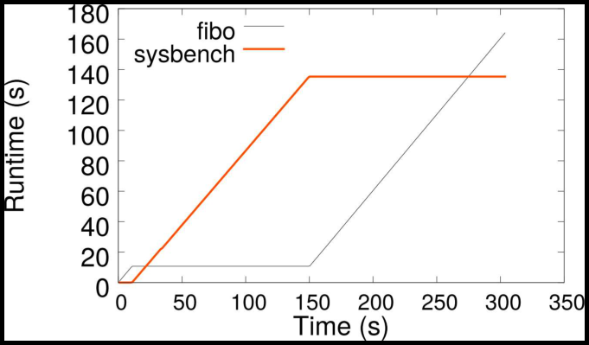
5. 3 Performance analysis.
Figure 5 presents the performance difference between CFS and ULE on a single core, with percentages above 0 meaning that the application executes faster with ULE than CFS.

Slide 41
5. 3 Performance analysis.
Overall, the scheduler has little influence on most workloads.The apache workload consists of two applications: the main server running 100 threads, and ab, a single threaded load injector.

Slide 42
6 Evaluation of the load balancer.
The Battle of the Schedulers

Slide 43
6 Evaluation of the load balancer.
In this section, we analyze the impact of the load balancing and thread placement strategies on performance. Next, we compare the performance of 37 applications running on CFS vs.. ULE.Finally, we analyze the performance of multiplication workloads

Slide 44
6. 1 Periodic load balancing.
The Battle of the Schedulers

Slide 45
6. 1 Periodic load balancing.
CFS relies on a rather complex load metric.All threads perform the same work, so we expect the load balancer to place 16 threads on each of the 32 cores.

Slide 46
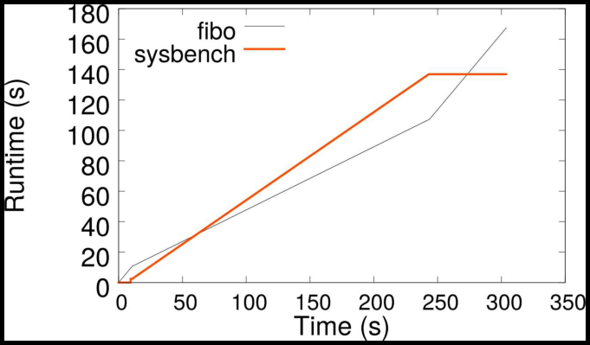
6. 1 Periodic load balancing.
Thread counts below 15 are represented in shades of gray.

Slide 47
6. 2 Thread placement.
The Battle of the Schedulers

Slide 48
6. 2 Thread placement.
We study the placement of threads using c-ray, an image processing application from the Phoronix benchmark suite. Then all threads wait at a barrier before performing the computation.Since all threads behave in the same way, we would expect ULE to perform better than CFS that configuration: ULE always forks threaded on the core with the lowest number of threads, so the load should be perfectly balanced from the start.

Slide 49
6. 3 Performance analysis.
The Battle of the Schedulers

Slide 50
6. 3 Performance analysis.
Figure 8 presents the performance difference between CFS and ULE in a multicore context.

Slide 51
6. 3 Performance analysis.
The delay is more than 50% because threads scheduled alone on their cores go to sleep, and then have to be woken up, thus adding latency to the barriers. This suboptimal thread placement also explains the performance difference between CFS and ULE on FT and UA.Contrary to Figure 6, threads do not start pinning on core 0

Slide 52
Performance.
The Battle of the Schedulers

Slide 53
Performance.
20 C-Ray DCraw johnjohn- johnscimark2- scimark2scimark2- scimark2scimark2- scimark2Build-apache 10 1 12 13 14 15 16 17 18 12 20 21 2 23 24 15 16 27 28 29 30 1 12 3 34 35 6 37 8 39 0 4 2 23 4 5 45 47 48 9 50 5 22 blackscholes fluidanimate streamcluster Figure 8: Performance of ULE with respect to CFS on a multicore.

Slide 54
Performance.
To validate this assumption, we replaced the ULE wakeup function by a simple one that returns the CPU on which the thread was previously running, and then observed no difference between ULE and CFS. 6% is the highest time spent in the scheduler we observed in CFS.

Slide 55
6. 4 Multi application workloads.
The Battle of the Schedulers

Slide 56
6. 4 Multi application workloads.
Finally, we evaluate the combination of interactive and background workloads using a set of different applications: c-ray + EP is a workload where both applications are considered background by ULE, fibo + sysbench and blackscholes + ferret are workloads where only one application is interactive, and apache + sysbench is a fully interactive workload.

Slide 57
6. 4 Multi application workloads.
This is expected, as they schedule background threads in a similar way.

Slide 58
6. 4 Multi application workloads.
Surprisingly, when co-scheduled with fibo, sysbench performs worse on ULE than on CFS even though it is correctly categorized as interactive and gets priority over five threads.

Slide 59
7 Related works.
The Battle of the Schedulers

Slide 60
7 Related works.
Previous works have compared the design choices made by FreeBSD and Linux.

Slide 61
-20 -40 -80 Perf. Improved relative to running alone on CFS -60.
The Battle of the Schedulers

Slide 62
-20 -40 -80 Perf. Improved relative to running alone on CFS -60.
CFS, multiple ULE single app ULE multiple c-ray Batch + interactive Interactive + interactive blackscholes apache sysbench Figure 9: Performance of CFS and ULE on multi application workloads with respect to the performance of the application running alone on CFS. average waiting time of threads in scheduler run queues.Groves et al.[9] compare the overhead of CFS against BFS, a simplistic scheduler aimed at improving the responsiveness on machines with few cores.

Slide 63
8 Conclusion.
The Battle of the Schedulers

Slide 64
8 Conclusion.
Scheduling threads on a multicore machine is hard.

Slide 65
REFERENCES.
The Battle of the Schedulers

Slide 66
REFERENCES.
[1] [PATCH] Fix bug in which the long term ULE load balancer is executed only once. In Proceedings of the 2005 ACM conference on Emerging network experiment and technology, ACM, pp.23] WONG, C. , TAN, I. , KUMARI, R. , LAM, J. , AND FUN, W. Fairness and interactive performance of O and CFS Linux kernel schedulers.

Slide 67
QnA

